Slide 1
Bayesian hypothesis testing
Bayesian t-test
Bayesian ANOVA
Bayesian linear regression
Bayesian
Bayesian
Bayesian
Notes:
So, William just talked to you about some of the principles of Bayesian reasoning. Now I want to cover how these are going to be applied within hypothesis tests that you might see in a journal.
Now, broadly speaking, most of the tools used in Bayesian statistical testing share some structural similarity to traditional tools of hypothesis testing. In the same way that we have these broadly-used tests such as the t-test, ANOVA, and linear regression… all of these have their equivalent in the Bayesian t-test, Bayesian ANOVA, and Bayesian linear regression.

Slide 2
Bayesian hypothesis testing
p-value
Linear formula
Bayes factor
Frequentist statistical tests
Parameter estimates
Data
Bayesian statistical tests
Priors
Confidence interval
Credible interval
Notes:
Now, even though they have the same name, frequentist and Bayesian statistical tests are working in a slightly different way.
Now, they do have a pretty similar structure. Frequentist tests will start with a linear formula and data, apply a test, and give us parameter estimates as well as confidence intervals and the p-value of statistical significance.
Bayesian analyses also have this linear formula, as well as of course the data. They also include another input, the prior beliefs, and they yield two different outputs in addition to the parameter estimates, the Bayes factor and the credible interval. I’ll go over all of these differences in slightly more detail over the next couple slides.

Slide 3
Specified priors
Bayesian hypothesis tests require specifying a prior
anything is possible! (uniform prior)
based on past data (informative prior)
reflect weak intuitions (uninformative priors)
Notes:
As we heard from William, Bayesian inference always requires a prior. So every Bayesian test that’s being done, that’s going to include a prior term. And this is a bit confusing, because it isn’t always clear what your prior beliefs *should* be. There are a few options:
We can place a uniform prior. This is increasingly avoided, however, because even when we don’t know a lot, it’s not necessarily sensible that an effect size of 10000% is equally likely to an effect size of 20%.
Sometimes you actually have a pretty clear impression of what results should look like – you have a strong prior. You’ll occasionally see it but it’s also pretty uncommon because most analyses want the data to speak for itself to some extent.
The most common prior used for Bayesian analyses is what is called an uninformative, or sometimes weakly informative prior. This prior does actually think some outcomes are more uncommon than others, but any plausible outcome should follow the evidence.

Slide 4
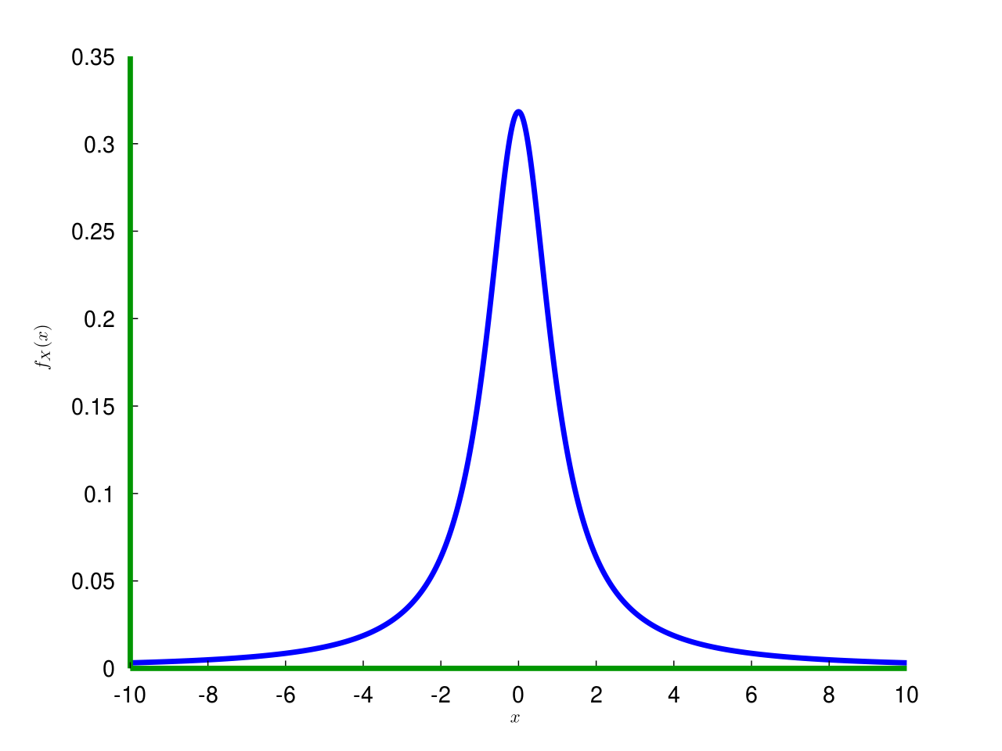
Specified priors
Many tools come with default (uninformative) priors
e.g. “We used the default JZS priors included in the BayesFactor package.”
“We used a weakly-informative prior of Normal(0.5,1) for the mean and a zero-truncated Cauchy(0,1) for the standard deviation.”
e.g., Cauchy prior
on effect size
Notes:
Now, these are pretty abstract, theoretical concepts, so I want to briefly cover how they are actually quantified in existing Bayesian hypothesis tests. A lot of these take the form of normal curves or other similar kinds of curves, like Cauchy distributions, that are more tolerant of outliers. When we specify a prior like this one, what we’re saying is an effect of zero is the most probable outcome, but larger positive or negative numbers.
By using weakly informative or uninformative priors, a lot of tools used for Bayesian statistical analyses include default priors. For example, the package BayesFactor in R has a set of default priors that are tolerant of most of the kinds of measurements you’ll find within psychological experiments, so you’ll often see something like this sentence. Or you might see someone specify a prior distribution for the mean and the standard deviation. These are more to give it a sense of what kinds of numbers are realistic (a number of say, 300 would be unreasonable according to this prior), than for example, whether a given effect is really real or not.
But let’s say we’ve specified our priors. We’re ready to interpret our data. How are we going to do it? In frequentist analysis, we would run a null-hypothesis significance test, and see if our data was really rare under the null with the p-value and reject the null if so. Bayesian analyses don’t have a p-value, but they have something relatively similar, as it turns out.

Slide 5
Bayes factor
A measure of strength of evidence
The Bayesian (sort-of) equivalent of the p-value
A likelihood ratio (requires at least 2 models)
Notes:
The Bayes factor.
Now, the Bayes factor is a measure of the strength of the evidence of a given data set for or against a hypothesis, which makes it sort of an equivalent to the p-value; for example, a high Bayes factor allows you to reject the null.
The Bayes factor does, however, require you to have at least 2 models to compare; for example, a null model and alternative model. This is because it is a ratio of the likelihoods of the two hypotheses.
Basically, what we’re saying with the Bayes factor is – forget the prior for a moment. Assuming hypothesis 1 was true, how likely would we be to find the data? Now, the same for hypothesis 2. Then we take the two of them and compare them directly – what is the one with stronger evidence in favour, all else being equal?

Slide 6
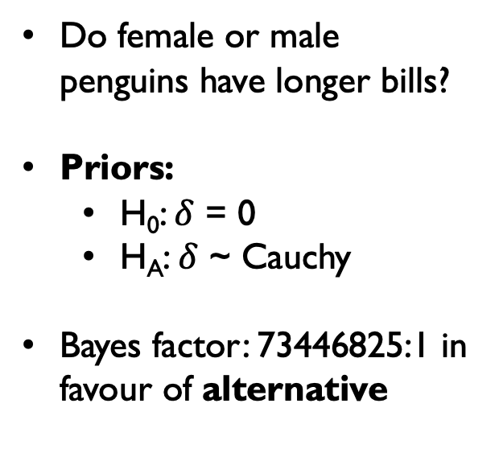
Bayes factor
Do female or male penguins have longer bills?
Priors:
H₀: $δ$ = 0
H_{A}: $δ$ ~ Cauchy
Bayes factor: 73446825:1 in favour of alternative
* Data from the palmerpenguins package (Horst et al., 2020, doi:10.5281/zenodo.3960218)
Notes:
Say you have some data about penguins, and you want to compare the bill length of penguins based on whether the penguins are male or female. Well, our hypotheses might either be that the difference is zero, or that the difference is something I don’t know exactly, but is probably sampled from this Cauchy distribution that would see a larger non-zero value as more typical.
If we just look at the likelihood of this data under these two different hypotheses, we find that the Bayes factor has a ratio of 73 million to 1 in favour of the alternative. Rather than using the term “statistically significant”, we say that this BF provides ”Strong evidence for the alternative”. So, the difference isn’t zero, and in fact male penguins have longer bills, and this analysis supports that conclusion.
Unlike frequentist p-values, Bayesian analyses can also reveal *strong evidence in favour of the null”. Bayes factors of less than 1 provide evidence for the null.

Slide 7
Bayes factor
Bayes factor value | Interpretation
BF ≥ 100 | Strong support for the alternative
20 ≤ BF < 100 | Moderate support for the alternative
3 ≤ BF < 20 | Weak support for the alternative
1/3 ≤ BF ≤ 3 | No decisive interpretation possible
1/20 < BF ≤ 3 | Weak support for the null
1/20 ≤ BF <1/100 | Moderate support for the null
BF ≤ 100 | Strong support for the null
* The exact values used may vary by researcher; see also Wagenmakers et al. (2018), Psychon Bull Rev
Notes:
Unlike with p < 0.05, there isn’t a definitive value for the Bayes factor that everyone’s agreed is “enough”, in part because as a continuous measure you can get more and more confident that one model is specifically preferred over another, and not just whether or not the null is a reasonable fit.
Nevertheless, BF > 3 or < 1/3 is often used as the minimum value to say anything more than anecdotal in terms of preferring one hypothesis over another. The larger numbers will sometimes vary – you might see 10 for moderate evidence instead of 20 for example, in part because these numbers will vary situationally. Unlike with frequentist stats, where larger sample sizes make it easier to find a statistically significant effect (which may or may not have come about by chance), Bayesian analyses will not make it easier to extract a “signal” out of noise, and may even make it harder.
So often times, you’ll see a researcher specify in advance what kind of Bayes factors they will use to make interpretations in a pre-registration or something like that.

Slide 8
Bayes factor
Interaction effect not clearly preferred or dispreferred (BF = 2.46)
Species + sex preferred to species alone (BF = 4e+33)
Species + sex preferred to sex alone (BF = 3e+110)
Comparing multiple/nested models
Notes:
Lastly, you can use the Bayes factor to compare against multiple nested models against each other.
For example, even though our original model of bill_length ~ sex is heavily preferred to the null, when we compare it to other models, such as species or species +sex, these models are much better at making predictions, by an order of almost 10^100!
We can also see that an interaction effect here is slightly less credible according to the Bayesian analysis, but not enough to make a definitive statement one way or the other.
Here is where it’s important to keep in mind that using the Bayes factor to compare models is only as good as your models. So if it’s missing a potential piece of the puzzle, the Bayes factor won’t be able to reveal that there’s a potential better model that you’re not including. For this reason, you’ll often see multilevel Bayesian models like this that include multiple terms, and sometimes modelling random effects such as individual differences.

Slide 9
Parameter estimation
Using the posterior distribution to calculate estimates of effects
Notes:
The other important feature I wanted to talk about is something that is also possible for frequentist statistics, but means something slightly different in Bayesian statistics, and that is parameter estimation. Basically, we want to get estimates for the size or extent of an effect. To do this, we need to use Bayesian inference to construct a posterior distribution of possible values

Slide 10
Parameter estimation
Sample the model many times to estimate possible values of difference in bill length
Model requires a sampling algorithm to estimate posterior
Many popular analysis packages based on Monte Carlo sampling (HMC, MCMC)
What was used to draw samples?
e.g. “To estimate the posterior distribution, we used a Markov chain Monte Carlo (MCMC) sampling algorithm, with 4 chains of 10,000 samples…”
How many samples were drawn?
(more = ↑ accuracy, ↑ time)
Notes:
As an example. Let’s say we want to go back to our penguin data and see whether male or female penguins have longer bills. Well, we saw that male penguins have longer bills, but we didn’t figure out how much longer.
Now, traditionally we would use numbers like the sample mean. But we also want to know just how credible that number really is, in intuitive terms that reflect our degree of certainty. In the case of Bayesian analysis, we want to get the posterior by integrating the prior with the likelihood of the observed data. To get an estimate of this distribution, we have to simulate, or sample, to see what kinds of values of, say, the bill length difference by sex, could give rise to the data that we saw.
There are a lot of tools and mathematical algorithms that will do this for you, so they are popular for many Bayesian analyses. Particularly popular are Monte Carlo sampling methods, which function by sort of doing a “random walk” from value to value and seeing how well it explains the data. You can see here, as it runs more and more iterations, it’s just bouncing from number to number, most of them between 2 and 5, and mostly around the “best values”. When you’ve drawn enough samples, this gives you a good estimate of the posterior distribution.
So, you’ll often see a mention of the package used for the analysis, as well as the method, such as the MCMC that I used here to determine the value for the difference between the male and female penguins. You’ll also see mention of the number of samples – more is usually more accurate, but also more computationally expensive, so there’s a tradeoff where more isn’t all that much more useful.
Finally, the number of chains – this is to make sure that our model is coherent. If you have multiple “chains”, or separate runs of the model, they should converge to equivalent values, yielding a high R-hat. So you’ll often see a line saying something like “Convergence was achieved, R-hat = 1.00”.

Slide 11
Parameter estimation
Determine credible values of the parameter
µ = –3.68
95% CI
[–4.8, –2.5]
“Female penguins had a bill length 3.68 mm shorter than males, 95% CI = [–4.8, –2.5].”
Notes:
Okay, convergence was achieved. Our model is good. What next?
Well, we want to determine the credible values for the parameter. So now, instead of plotting the values over time, we’re going to see how many of each value showed up a certain number of times. Our value here, mu, is the value with the highest probability density. It’s not exactly the same as the mean, because our prior beliefs are going to tug it towards that value a little bit, but especially with a weak prior it’s pretty close.
Then we have the credible intervals. As William said, it’s similar to confidence intervals in appearance, but interpretation is different. This is where you place 95% of your certainty.
You’ll often see this written out in analyses pretty simply: “Female penguins had a bill length 3.68 mm shorter…”
This example uses the mean difference on a single value with one predictor variable, but Bayesian analysis lets you calculate the posterior predictives for the mean, standard deviation, effects from variables with 3+ factors, or continuous linear effects. In general, anything you could estimate with frequentist statistical analyses, you can do with Bayesian statistical analysis, but the things that I’ve covered today are some of the most common implementations you’ll see in journal articles that use Bayesian inference to analyze data.

Slide 12
Questions and more information
Data from this presentation is publicly available at http://github.com/rgelpi/socdevbayes
For questions or comments about the presentation:
Rebekah: rebekah.gelpi@mail.utoronto.ca
William: william.ai@mail.utoronto.ca
Notes:
If you would like more information, the data used to generate the graphs and analyses in this presentation are available on GitHub, and if anything wasn’t clear during the presentation or you have any outstanding questions, feel free to reach out to us via email. Thanks for listening!

